Slide 1
Meraki and Alexa integration
Manage your Guest Wi-Fi with your voice
Mitja Rakar
Systems Engineer
@meetyaaR

Slide 2
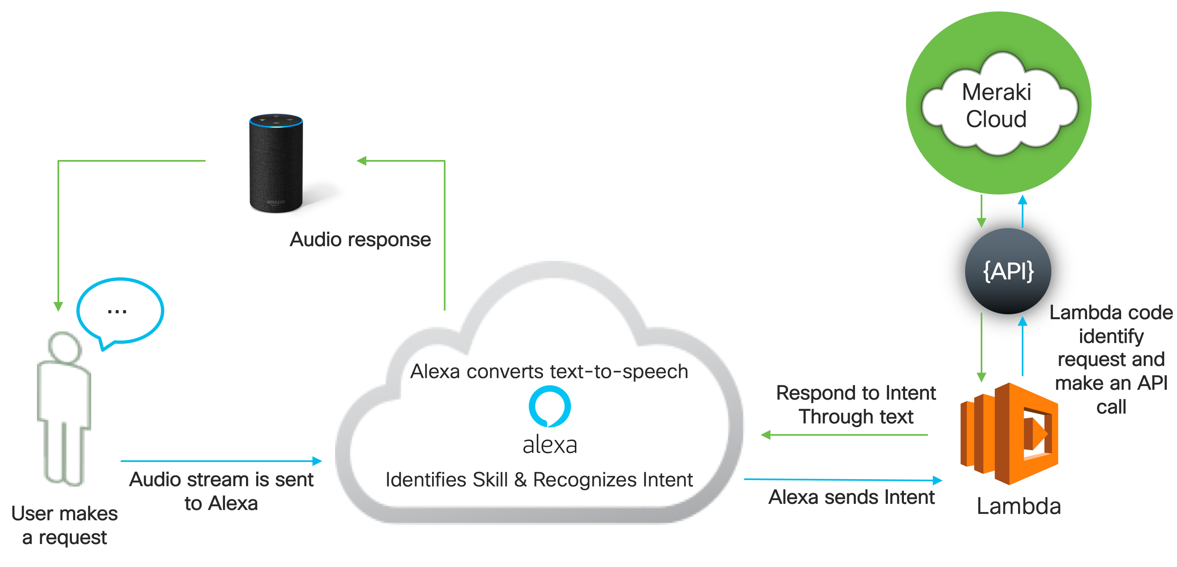
Scenario

Slide 3
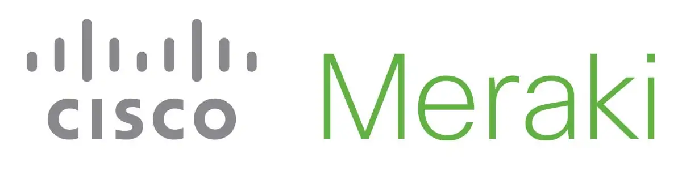



Prerequests
- Cisco Meraki gear and access to the Cisco Meraki dashboard
- Amazon Alexa device
- Amazon developer account
- AWS account

Slide 4
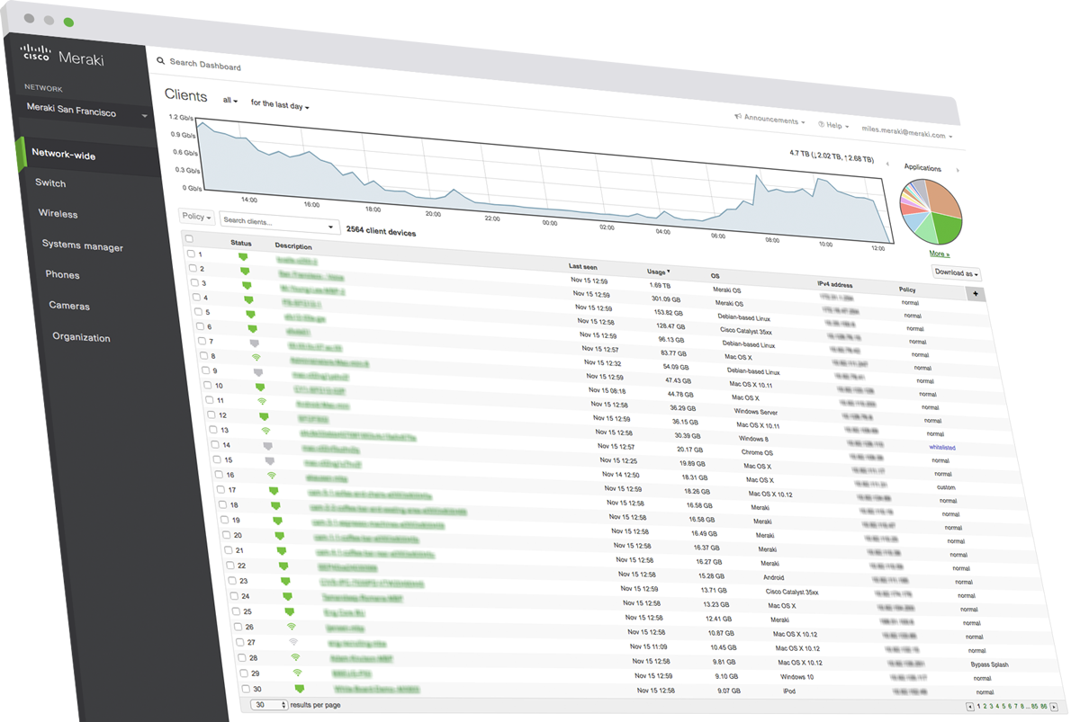
Get the variables values
MERAKI_API_KEY – Meraki dashboard API
MERAKI_ORG_NAME – name of the organization
MERAKI_NET_NAME – name of the network
MERAKI_SSID_NAME – SSID of the guest WiFi
http://dashboard.meraki.com

Slide 5
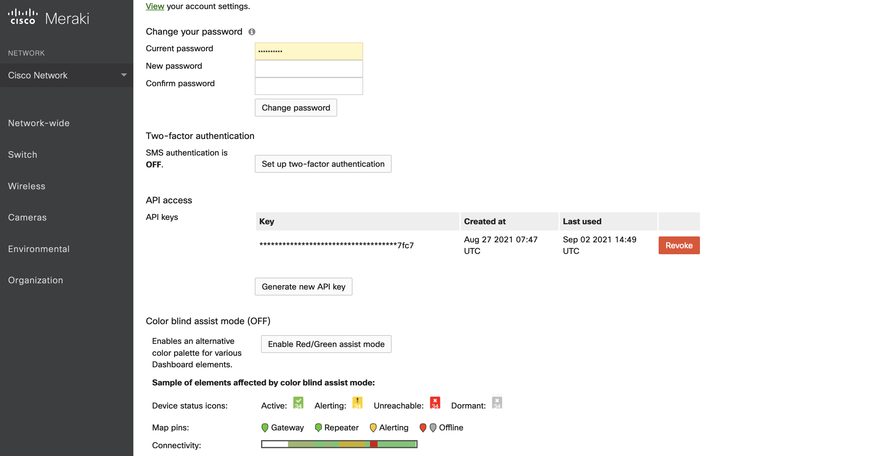
MERAKI_API_KEY
[your email] > My profile > API access
If you don’t have the token, create one with Generate new API Key and save it securely.

Slide 6
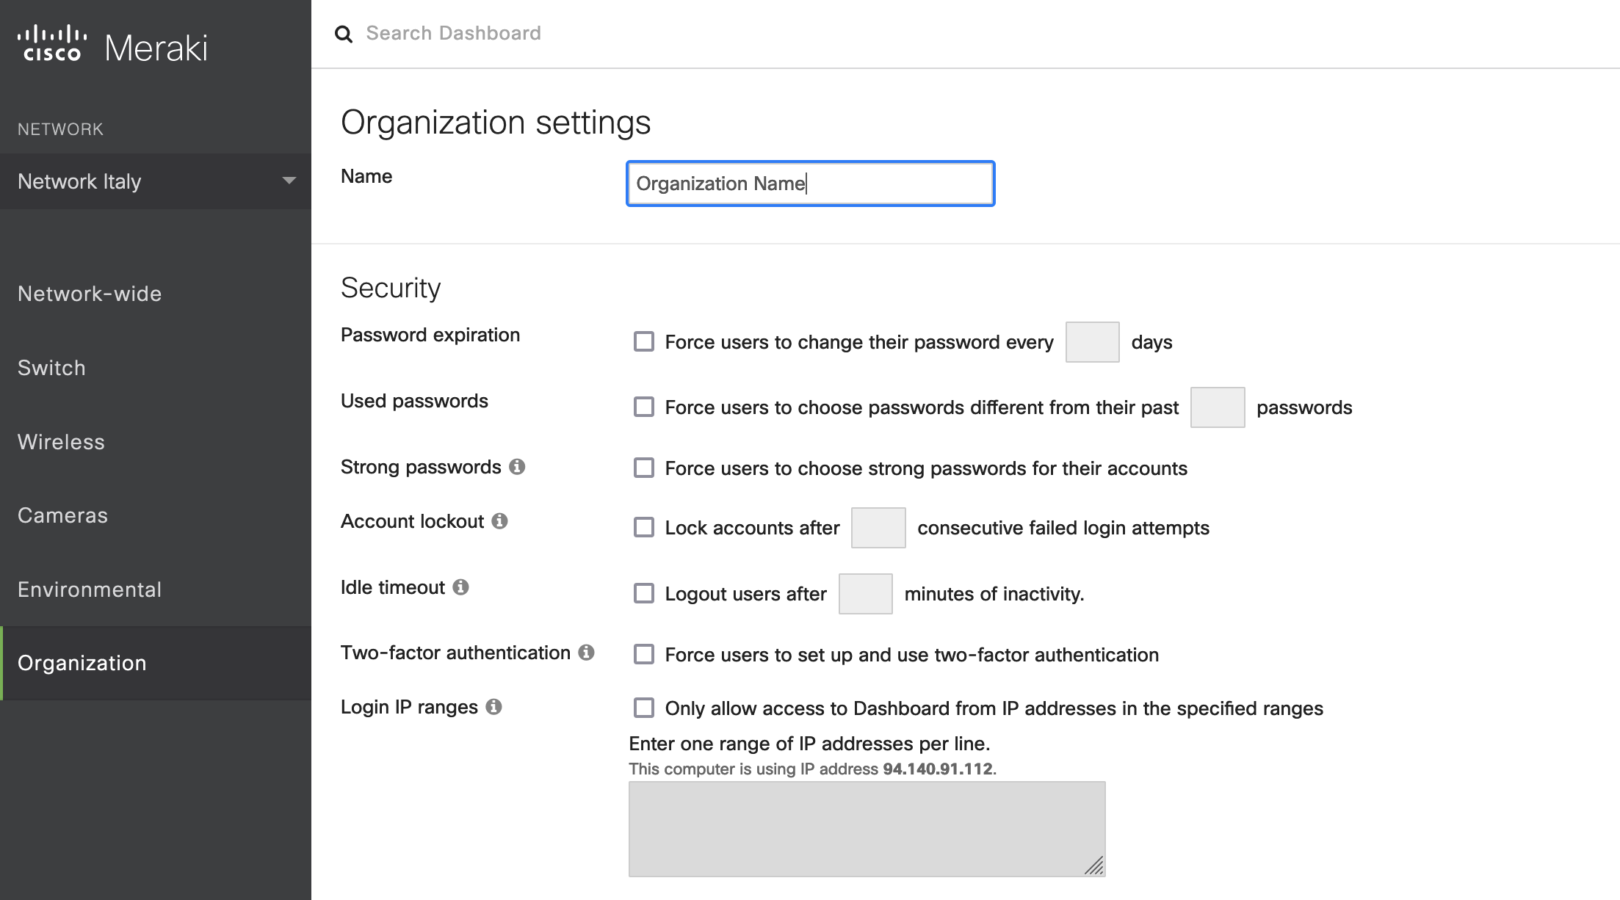
MERAKI_ORG_NAME
Organizations > Settings > Name

Slide 7
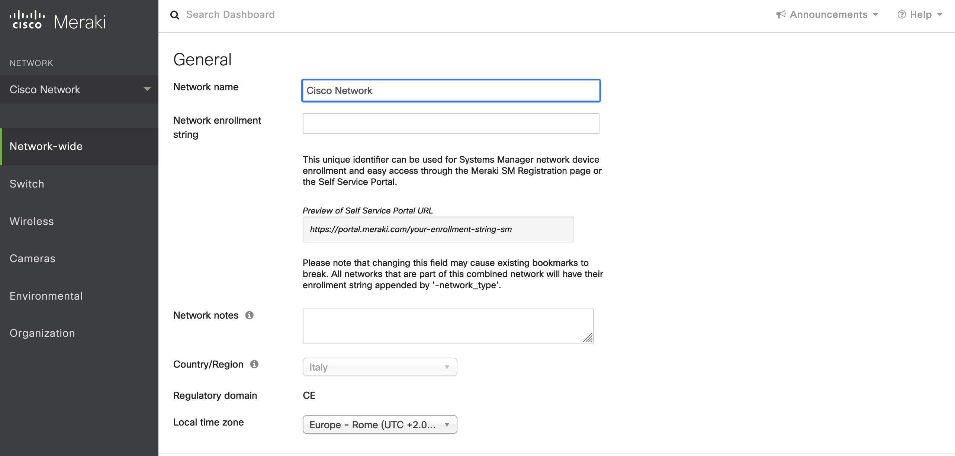
MERAKI_NET_NAME
Network-wide > General > Network name

Slide 8
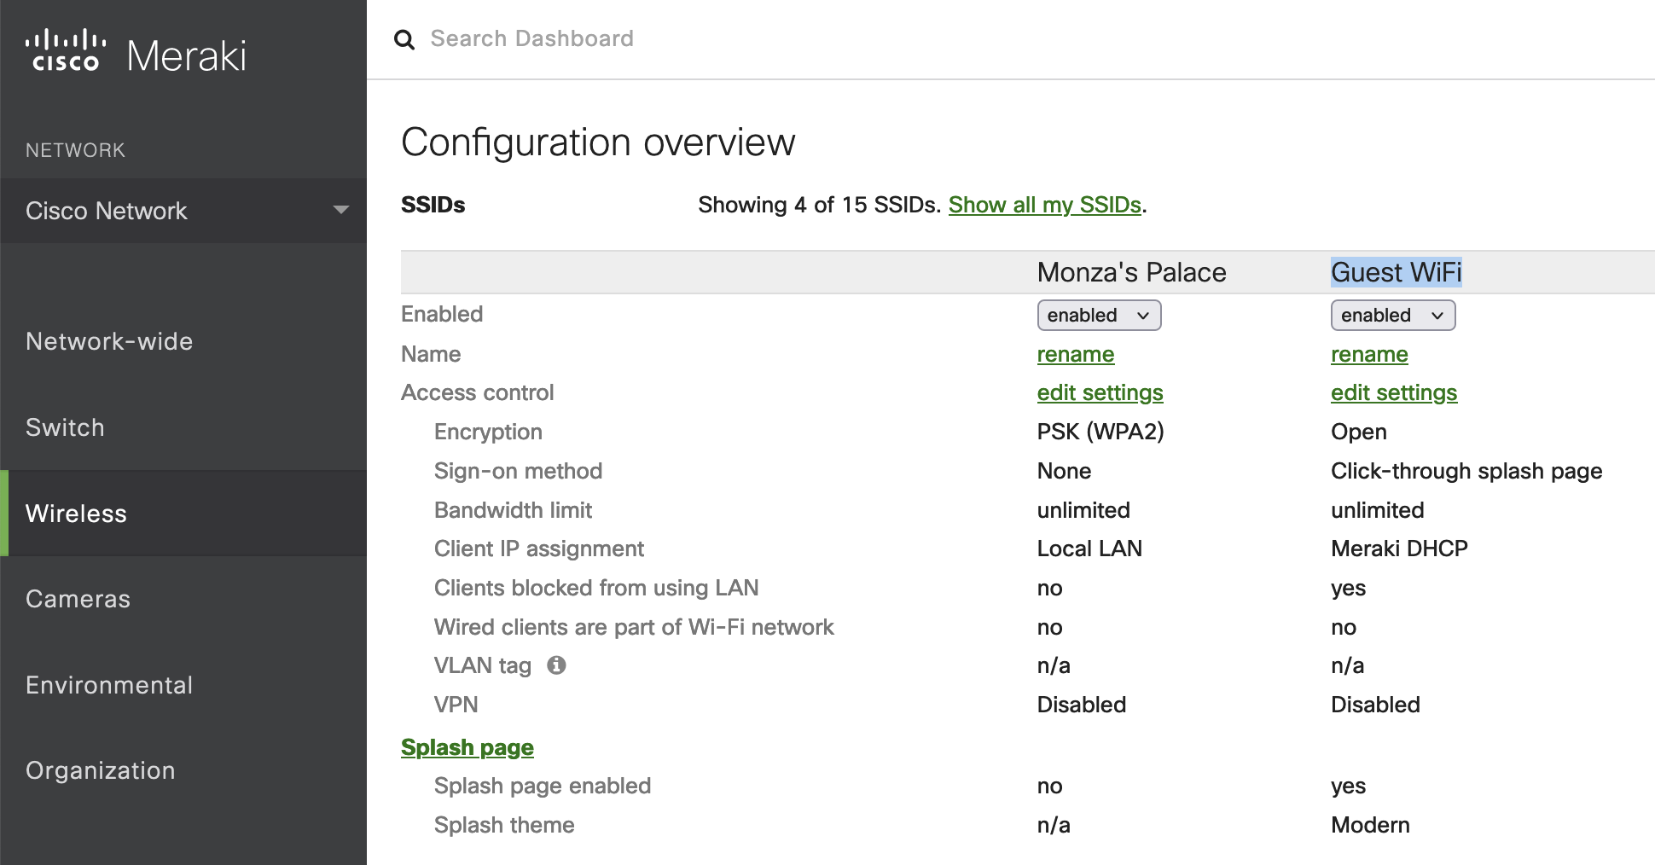
MERAKI_SSID_NAME
Wireless > SSIDs > Guest SSID name

Slide 9
Prepare the values
MERAKI_API_KEY – 7ac03e10bf254d156c2af5895b53f53bfae97f89
MERAKI_ORG_NAME – Organization name
MERAKI_NET_NAME – Cisco Network
MERAKI_SSID_NAME – Guest WIFI
http://dashboard.meraki.com

Slide 10
Next steps
Download the script
Create the lambda function and upload the files as a ZIP
Create an Alexa intent
Link Alexa with the lambda function
Test the new created Alexa skill

Slide 11
Try iy yourself
Alexa, ping my netowrk
Turn the WiFi on/off
What is the Guest WiFi password?
How many clients are connected?
What is the status of the Guest WiFi?
What is going on with my network?
Get the roadmap
Thank you APIs

